Slide 1
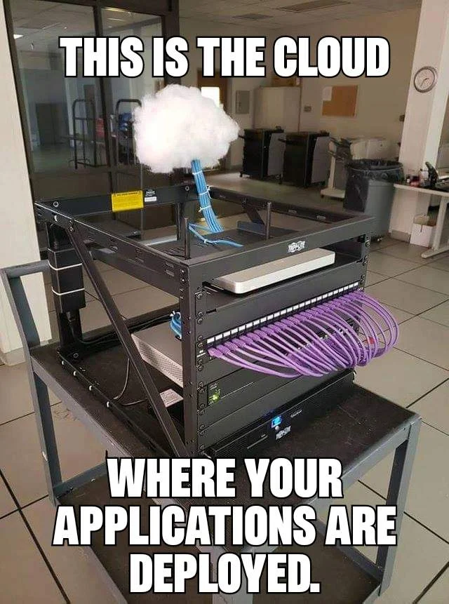
Virtual machines
Inf-2201, University of Tromsø, Spring 2019
Lars Ailo Bongo
lars.ailo.bongo@uit.no
Including slides from Andy Bavier, Princeton University

Slide 2
Cloud Computing
Utility computing: on-demand provision of storage and compute resources over a network
Key concepts:
Customers pays for as little or much resources as they need (elasticity)
Vendors goal is to optimize resource utilization ➔ run multiple clients on same machine
Service level agreement regulates quality of service
How to share a machine and offer required protection?

Slide 3
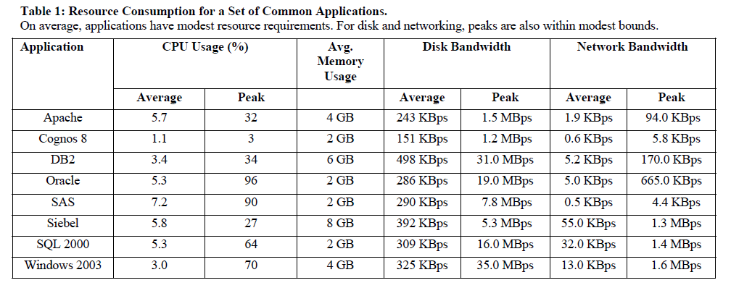
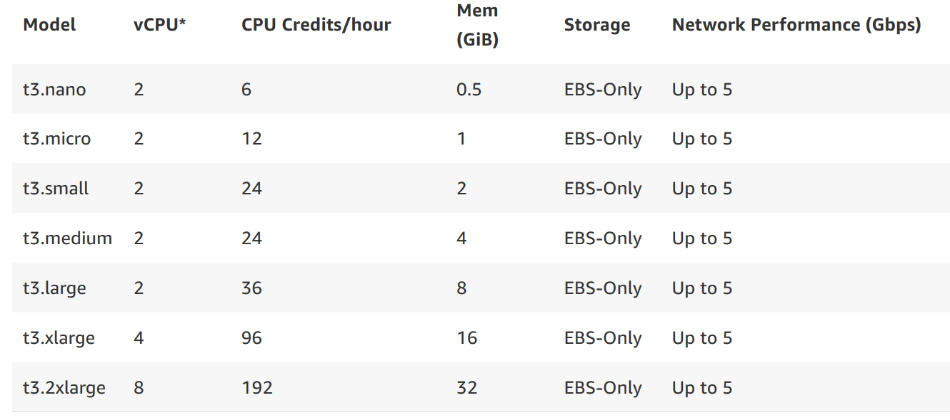
Datacenter Workload
Source: The Impact of Management Operations on the Virtualized Datacenter. Soundararajan and Anderson. ISCA’10.

Slide 4
Virtual Machine Monitors (VMM)
Layer below the operating system
Presents hardware interface to an OS
Multiplexes resources between several virtual machines (VMs)
Isolates VMs from each other
Separate address spaces
Performance isolation (to some degree)

Slide 5
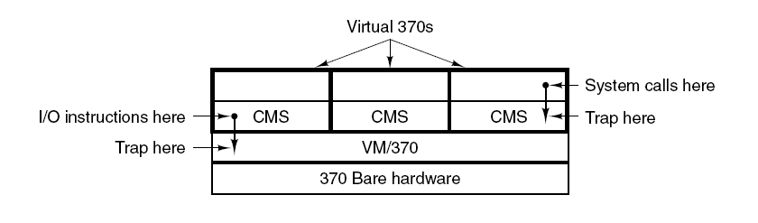
VM/370 with CMS
VM/370: VMM
CSM: an advanced shell

Slide 6
History
Have been around since the 1960’s on mainframes
VM/370: used for multitasking
Resurfaced on commodity platforms in 2000’s
Server consolidation
Web hosting centers
Managed desktop/ thin-client/ browsers
Software development (such as kernels)
Linux in Windows
Cloud computing

Slide 7
Design Issues
Manageability
Ease of maintenance, administration, provisioning, etc
Performance
Minimize overhead of virtualization
Isolation
Data of one VM should not be accessible from others (security)
Activity of one VM should not impact other VMs (performance isolation)
Scalability
Minimize cost per VM

Slide 8
Processor Virtualization
Popek and Goldberg (1974)
Sensitive instructions: only executed in kernel mode
Privileged instructions: trap when run in user mode
CPU architecture is virtualizable only if sensitive instructions are subset of privileged instructions
When guest OS runs a sensitive instruction, must trap to VMM so it maintains control

Slide 9
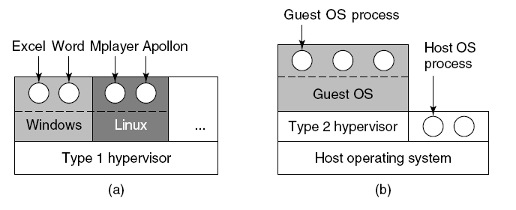
VMM Types

Slide 10
Virtualization Styles
Fully virtualizing VMM
Para-virtualizing VMM
Requires changes to host OS

Slide 11
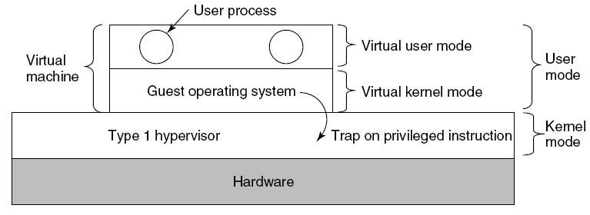
Type 1 Hypervisors

Slide 12
Revisit Microkernels
How does a microkernel differ from a Type 1 Hypervisor?

Slide 13
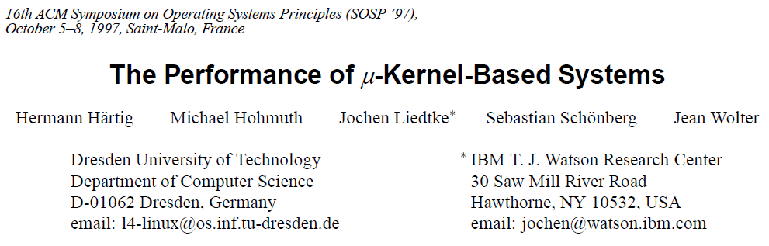
Classic Microkernel Paper
Describes how to implement an efficient microkernel
Measures overhead of running Linux on top of L4 microkernel
(Prof. Härtig was a good friend of the department)

Slide 14
“Are Virtual Machines Microkernels Done Right?”
HotOS’05 paper by Hand, et. Al.
(note! HotOS papers are often written to be controversial)
Claim that VMM are better since they
Kernel is not dependent on user level components
Make IPC performance irrelevant
Treat the OS as component
Do you agree?
What will the future bring?

Slide 15
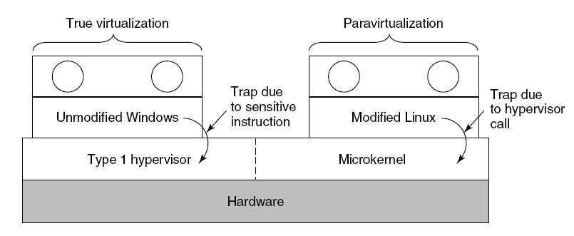
Paravirtualization

Slide 16
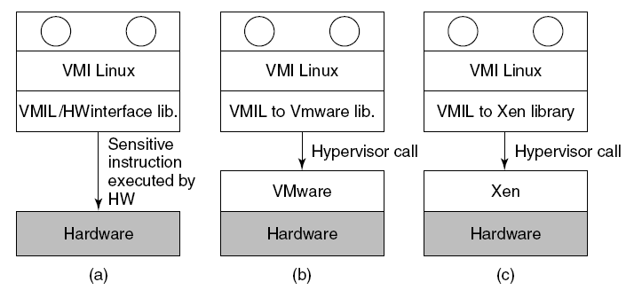
Paravirtualization (2)

Slide 17
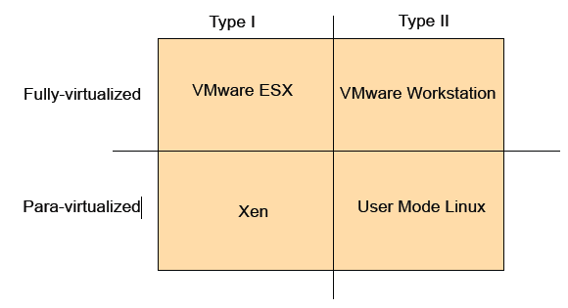
VMM Classification

Slide 18
VMM Implementation
Efficiently virtualize the hardware
Provide illusion of multiple machines
Retain control of the physical machine
Subsystems
Processor Virtualization
Memory Virtualization
I/O virtualization

Slide 19
x86 Processor Virtualization
x86 architecture is not fully virtualizable
Certain privileged instructions behave differently when run in unprivileged mode
Certain unprivileged instructions can access privileged state
Techniques to address inability to virtualize x86
Static replacement of non-virtualizable instructions with easily virtualized instructions (Para-virtualization)
Perform binary translation (Full Virtualization)
Since 2005 (Intel) and 2006 (AMD): HW virtualization support

Slide 20
Memory Virtualization
Traditional way is to have the VMM maintain a shadow of the VM’s page table
The shadow page table controls which pages of machine memory are assigned to a given VM
When guest OS updates its page table, VMM updates the shadow page table

Slide 21
I/O Virtualization
Issue: lots of I/O devices
Problem: Writing device drivers for all I/O device in the VMM layer is not a feasible option
Insight: Device driver already written for popular Operating Systems
Solution: Present virtual I/O devices to guest VMs and channel I/O requests to a trusted host VM running popular OS

Slide 22
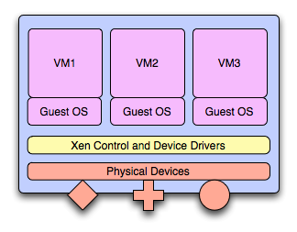
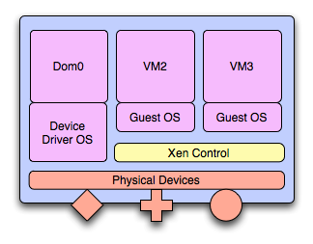
I/O Virtualization

Slide 23

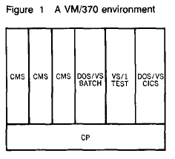
IBM VM/370
Type 1, fully virtualized
HW, VMM, and guest OS co-designed
Released in 1972
Successor z/VM still in use today on mainframes
It provides: “multiple software replicas of real computing systems on one real processor” [Seawright and Mackinnon, 1979]

Slide 24
“Usefulness of VM/370”
Run multiple versions of an OS
Test upgrades to an OS
Backward compability for old applications
System integrity and isolation
Computer science “laboratory”

Slide 25
VM/370: Memory and I/O Virtualization
Memory virtualization:
Each virtual machine has separate address space
CP (VMM) has no dynamic paging
I/O Virtualization:
Physical disk divided into continuous cycles (minidisk)
Each VM has separate minidisk
Access control implemented for minidisks
Host operating systems rewritten to use VMM
Hardware support for VMM operations

Slide 26
VMware ESXi Server
Type I VMM - Runs on bare hardware
Full-virtualized – Legacy OS can run unmodified on top of ESXi server
Fully controls hardware resources and provides good performance
Enterprise solution

Slide 27
ESXi Server – CPU Virtualization
Most user code executes in Direct Execution mode; near native performance
Runtime Binary Translation for x86 virtualization
Privileged mode code is run under control of a Binary Translator, which emulates privileged instructions
Fast compared to other binary translators as source and destination instruction sets are nearly identical
Can binary translated code outperform HW supported code?

Slide 28
ESX Server – Memory Virtualization
Maintains shadow page tables with virtual to machine address mappings.
Shadow page tables are used by the physical processor
ESX maintains the pmap data structure for each VM with “physical” to machine address mappings
ESX can easily remap a machine page

Slide 29
ESXi Server – Memory Management
Page reclamation – Ballooning technique
Reclaims memory from other VMs when memory is overcommitted
Page sharing – Content based sharing
Eliminates redundancy and saves memory pages when VMs use same operating system and applications

Slide 30
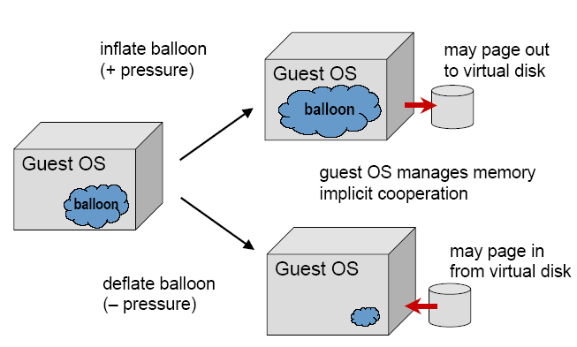
ESX Server- Ballooning

Slide 31
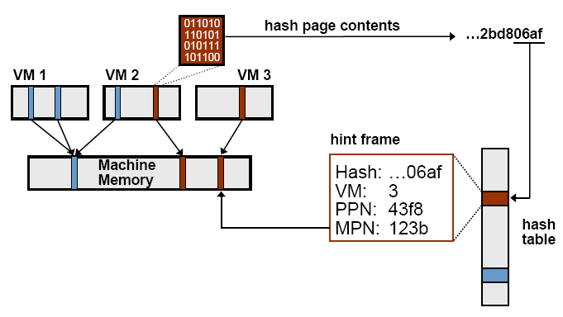
ESX Server – Page Sharing

Slide 32
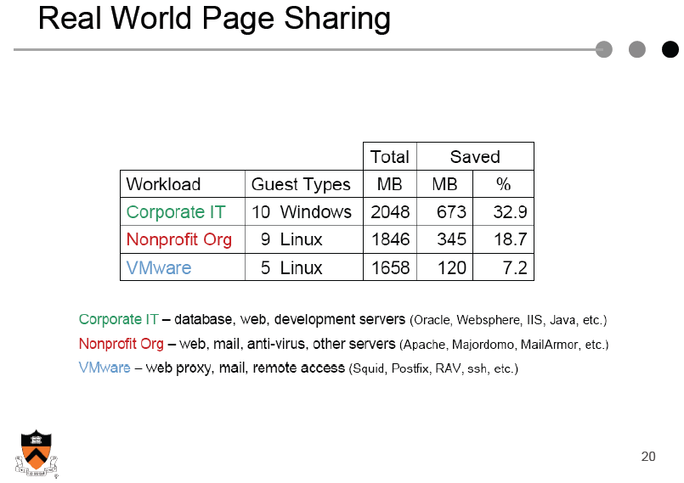

Slide 33
ESXi Server – I/O Virtualization
Has highly optimized storage subsystem for networking and storage devices
Directly integrated into the VMM
Uses device drivers from the Linux kernel to talk directly to the device
Low performance devices are channeled to special “host” VM, which runs a full Linux OS

Slide 34
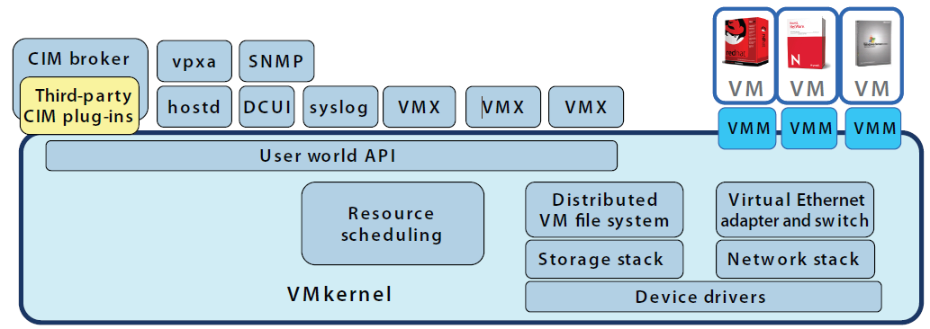
ESXi Architecture

Slide 35
VMkernel
(from ESXi Architecture white paper)
POSIX-like operating system
Process creation and control, signals, file system, process threads…
Designed to support multiple virtual machines
Simple in-memory file system (configuration files, logs, patches)
User and groups (management and administration)
“User worlds”: limited POSIX framework to run hypervisor

Slide 36
VMware Workstation
Type II VMM - Runs on host operating system
Full-virtualized – Legacy OS can run unmodified on top of VMware Workstation
Appears like a process to the Host OS
Free version: WMware player

Slide 37
Workstation - Virtualization
CPU virtualization and memory virtualization
Uses Similar Techniques as the VMware ESXi server
I/O Virtualization
Workstation relies on the Host OS for handling I/O requests
I/O incurs overhead as it has to switch to the Host OS on every IN/OUT instruction.

Slide 38
Workstation – I/O Virtualization
VMM must be able to intercept all I/O operations issued by the Guest OS
These are trapped by the VMM and emulated either in VMM or VMApp.
Any access that interact with physical hardware have to be handled by VMApp
I/O intensive workload performs poorly due to extra host switches between the Host and the VMM worlds

Slide 39
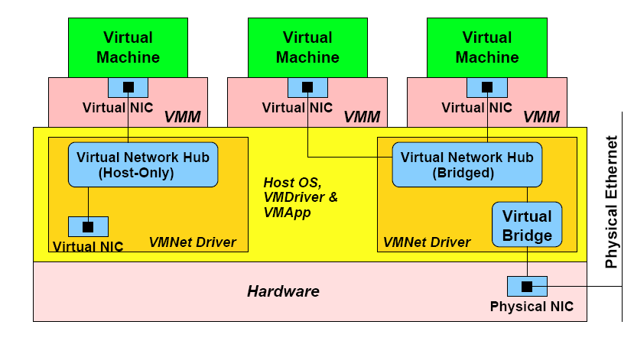
Workstation – Virtualize NIC

Slide 40
VMM Hardware Support
CPU virtualization support:
Intel VT introduced in 2005 and AMD-V introduced in 2006
Memory management support:
Extended page tables
I/O MMU virtualization
Intel VT-d and AMD-Vi
Network virtualization: Intel VT-c
Most VMMs utilize HW support

Slide 41
CPU Virtualization Support
Virtual machine control block (VMCB): control state with subset of the guest virtual CPU
Less privileged execution mode: guest mode
New instruction vmrun executed by VMM:
HW loads guest state from VMCB and switches to guest mode
Run until some condition expressed by VMCB is reached
Exit from guest mode:
HW saves guest state in VMCB
HW loads VMM supplied state to HW
Resume executing VMM

Slide 42
MMU Support
Extended page tables (EPT):
Ordinary pages tables: virtual to guest-physical addresses
EPT: guest-physical to host-physical addresses
TLB entries map virtual to host-physical addresses

Slide 43
EPT - TLB Miss
Miss on virtual address V
Use guest table pointer (cr3) to locate guest page directory
Map guest-cr3 address to host-physical address by walking nested page tables
Read page table entry in guest page directory
Map guest page table address to physical memory
Read guest-physical address in page table
Map guest-physical to host host-physical address
Resume execution

Slide 44
Intel VT for Directed I/O
(from Intel VT for Directed I/O – Architecture Specification)
I/O device assignment: for flexibly assigning I/O devices to VMs and extending the protection and isolation properties of VMs for I/O operations.
DMA remapping: for supporting independent address translations for Direct Memory Accesses (DMA) from devices.
Interrupt remapping: for supporting isolation and routing of interrupts from devices and external interrupt controllers to appropriate VMs.
Reliability: for recording and reporting to system software DMA and interrupt errors that may otherwise corrupt memory or impact VM isolation.

Slide 45
Xen
Type I VMM
Para-virtualized
Open-source
Designed to run 100s of virtual machines on a single machine
Commercial version: Citrix Xen

Slide 46
Xen – CPU Virtualization
Privileged instructions are paravirtualized by requiring them to be validated and executed with Xen
Processor Rings
Guest applications run in Ring 3
Guest OS runs in Ring 1
Xen runs in Ring 0
Guest OS code must modified

Slide 47
Xen – Memory Virtualization
Initial memory allocation is specified and memory is statically partitioned
A maximum allowable reservation is also specified.
Balloon driver technique similar to ESX server used to reclaim pages
Guest OS is responsible for allocating and managing hardware page table
Xen involvement is limited to ensure safety and isolation
Xen exists in the top 64 MB section at the top of every address space to avoid TLB flushes when entering and leaving the VMM

Slide 48
Xen – I/O Virtualization
Xen exposes a set of clean and simple device abstractions
I/O data is transferred to and from each domain via Xen, using shared memory, asynchronous buffer descriptor rings
Xen supports lightweight event delivery mechanism used for sending asynchronous notifications to domains

Slide 49
Other VMMs
Microsoft Hyper-V
Oracle VirtualBox
Type 2, fully virtualized
Open source
Nice documentation
Is bochs a virtual machine?
Other?

Slide 50
Summary
Cloud as motivation for virtualization
Virtual machine monitor design and classification
Type 1 vs. Type 2
Fully virtualized vs. paravirtualized
Design of different VMMs

Slide 51
References
Data center workload
L4 paper
HotOS paper
VM/370 paper (VM/370 – a study of multiplicity and usefulness)
VMWare paper
Xen paper
VMWare ESXi whitepaper

